Slide 1
HOW to check your pay (2019)
By Wendell Head
This is meant to explain how your pay and deductions are determined, and to help you identify potential errors. It is based upon CURRENT contribution rates and fees, so trying to apply these calculations to pay stubs from the past might not work. Furthermore, there may be additional factors not addressed here (such as principal allowances, income tax exemptions, etc). If you have specific questions regarding your pay, please contact me.

Slide 2
Faq – Before we get into details
Why does my pay always seem to fluctuate throughout the year?
First of all, it’s important to remember that pension contributions are deducted for actual days worked in a pay period. Some pay periods have more days than others, so it varies. On December 31st, for example, you may notice that your take-home pay is higher than usual because you’ve already been off for a week and are only paying TRAF for maybe 5 days. You will notice the same thing after Spring Break, and again all summer long. You aren’t actually working in July and August, so you aren’t making any TRAF contributions.
It’s also important to remember that your CPP an EI contributions are deducted beginning in January of each year at a specific rate until you reach a maximum. Once you reach the maximum, those deductions stop, and your take-home pay is higher as a result. When does it stop? Well, it depends on your salary, If you’re at the top of the pay grid, you’ll reach the maximum sooner. If you’re a newer teacher at a lower salary, you’ll reach the maximum later. (If you’re in your first year, you probably won’t reach it at all in your first year, but only in your second year) For most, it happens somewhere between August and October.
In the end, you need to remember that your gross pay is still the same – it’s only your take-home pay that changes. While this might make it a little more challenging for budgeting, once you understand how this works, you can plan accordingly.

Slide 3
Faq – Before we get into details
2. Why can’t my take-home pay just be the same every time?
Well, to put it simply, the Division has to follow the rules and laws in place for making these deductions (and some of these rules have changed over the years). They have no choice in how this is done. Plus, it actually reduces the potential for errors, especially with our pension contributions. While that might make it a little more confusing, that’s why it’s important to work through the following slides – so you can understand how it works, and make better financial plans.
3. I’m in my 5th year of teaching – Why am I only on step 4 of the grid?
You have to remember that you don’t get credit for a year on the grid until you’ve actually finished the year. That’s why you are actually at step 0 when you start teaching. You don’t get to step 1 on the grid until you’re in you’re second year of teaching. It’s also important to remember that any substitute teaching or short-term contracts you may have done also count towards your experience, and will have an impact on when you move up on the grid.

Slide 4
Understanding your pay statement
Understanding the answers to these frequently asked questions is just the beginning. If you really want to check your pay, you must understand HOW these deductions are calculated.
Here we go…..

Slide 5
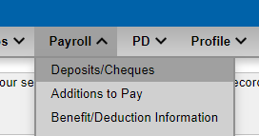
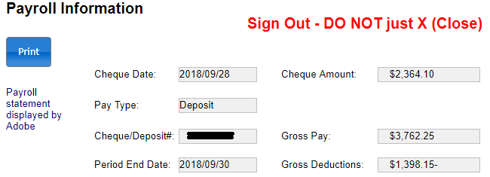
First Get your pay STUB
Login to CIMS, click the “Payroll” tab, and then on “Deposits/Cheques” from the drop-down list to get to the “Payroll Information” page.
To see a one-page “Statement of Earnings” with all your information in an easy-to-read format, click “Print.”
NOTE: It’s a good idea to create PDFs
of ALL your pay statements and save
them for your records.

Slide 6
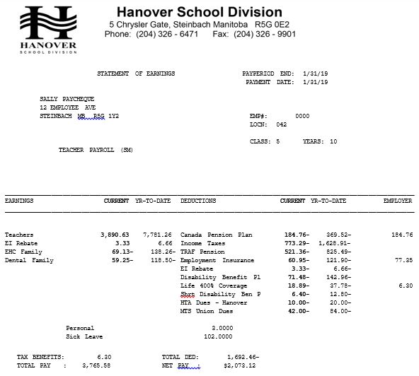
STATEMENT of Earnings
1
Your pay statement has 5 main areas:
Basic Information
Earnings
Deductions
“Banked” Days
Summary
2
3
4
5

Slide 7
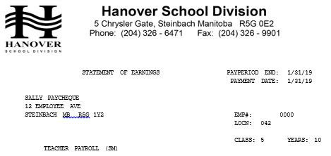
Check basic information “SALLY PAYCHECK”
Verify that your name and address are correct.
Make sure that the classification you have received from Teacher Certification is the same as this one.
Make sure the years experience shown here is correct.

Slide 8
Basic Information; Are your years correct?
Remember, years experience must be completed to be counted. For example, if you are in your 7th year of teaching now, the “Years” on your pay stub should be 6, because you haven’t actually completed the 7th year yet. That’s why there’s a step 0 on the salary grid.
Also note that “years” are cumulative, not chronological. For example, if you were a substitute for parts of a year or a couple of years, that experience must add up to 180 teaching days before it can count as a “year” on the grid. Multiple term contracts also count.
You can always contact Teacher Certification to verify the experience they have counted and given you credit for. Their contact information:
Phone: (204)773-2998
Email: certification@gov.mb.ca

Slide 9
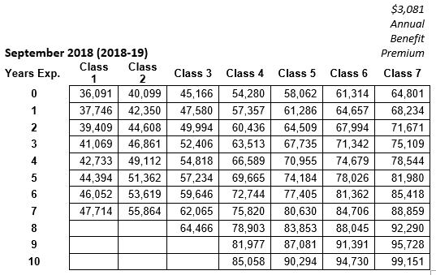
SALARY: Understanding the Grid
Once you confirm your classification and years, go to the salary grid in our most recent Collateral Agreement for 2018-19 (pictured on the left). REMEMBER that our benefits are PRE-Tax, so your total compensation is the number on the grid PLUS the “Annual (Family) Benefits Premium,” which for the 2018-19 year, is $3081.
So what is “Sally Paycheque’s” salary?
TAXABLE Salary = $90,294

Slide 10
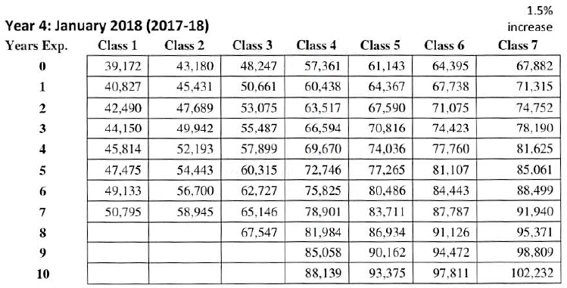
SALARY: Understanding the (OTHER) salary griD
You may wonder why there are TWO salary grids for 2018-19. Well, the one in the Collateral Agreement is for the members who pay into the Dental and Extended Health Care plans. The second grid, on page 31 of the CBA, is the one with ACTUAL salaries (before the pre-tax deductions). This is the grid that you should use if you do NOT pay for Dental and EHC.
Notice how the Class 5, Year 10 salary on this grid is equal to the Class 5, Year 10 salary from the previous grid PLUS the benefits premium!
Note that this grid is the gross grid that came into effect January 2018 – until we have a new Collective Agreement, we will continue with this one. Meanwhile, if our EHC and Dental premiums change, a new Collateral Agreement will be created with a grid to reflect the change in premiums.

Slide 11
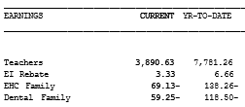
EARNINGS: Are theY correct?
Since “Sally Paycheque” is a Class 5 with 10 years, her salary is $93,375.
$93,375 ÷ 24 = $3890.63
This means the current pay is correct!!

Slide 12
EARNINGS: The EI Rebate
What is the EI Rebate? Because members can accumulate 130 sick days, you qualify for a reduction in your EI premiums. This reduction is the EI rebate shown on your pay stub.
Why is the exact same amount deducted again? If you keep it, you have to pay taxes on it. For years, all Teachers’ Associations in MB have negotiated that the teacher portion of these rebates be paid directly to the Associations, because the Associations do NOT have to pay taxes on it. It therefore gives members far better value in terms of off-setting Association fees. As of September, HTA will get any further rebates that result from the Short-Term Disability Plan.
In terms of checking your pay, as long as the amount “earned” equals the amount deducted, then you don’t have to worry about it.

Slide 13
EARNINGS: The Ei Rebate
PER
Are the Earning and Deduction the same for the EI Rebate?

Slide 14
EARNINGS: Extended Health Care & Dental
Why are the Health Benefits listed as earnings? Aren’t they actually deductions?
Well, yes, but they are PRE-TAX deductions. You see, deductions like income tax are based upon a percentage of your salary. Because your EHC and Dental are taken off BEFORE the income tax is calculated, you actually pay less income tax. That means you’re taking home more money each pay, or “earning” more. So it’s in the “Earnings” column.

Slide 15
EARNINGS: pre-tax deductions for health and dental
Extended Health Care Premium
Single: $798 / year ($798 ÷ 24 = $33.25)
Family: $1659 / year ($1290 ÷ 24 = $69.13)
Dental Care Premium
Single: $345 / year ($345 ÷ 24 = $14.38)
Couple: $678 / year ($678 ÷ 24 = $28.25)
Family: $1422 / year ($1353 ÷ 24 = $59.25)
NOTE: Your taxable salary is your “Teachers Current” subtract your EHC and Dental.
Taxable Salary = $3890.63 – $69.13 – $59.25
= $3762.25

Slide 16
DEDUCTIONS: Canada pension plan
Your Canada Pension Plan contribution is calculated based upon 5.1% of your salary to a maximum of $2748.90 in 2019.
Each person is allowed a basic exemption amount of $3500.00 which is divided amongst all 24 pay periods ($145.83 per pay period) and subtracted from your salary BEFORE the percentage is calculated for your deduction. The CPP rate also applies to any taxable benefits that HSD pays for (such as life insurance).

Slide 17
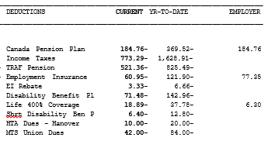
DEDUCTIONS: CPP Calculation
CPP = 5.1% of (Taxable Salary – Exemption + EMPLOYER Paid Life Insurance)
= 0.051 x ($3762.25 - $145.83 + $6.30)
= 0.051 x $3622.72
= $184.76
Is the “EMPLOYER” contribution to
your CPP exactly the same?
Is the “YR-TO-DATE” deduction for
CPP less than or equal to the annual
maximum ($2748.90 in 2019)?

Slide 18
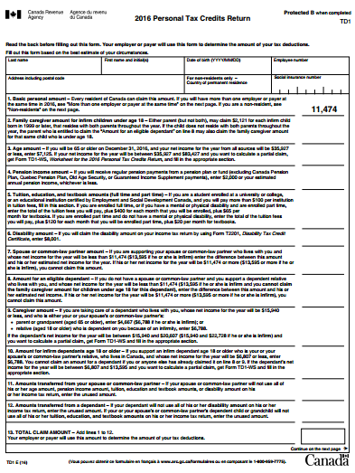
DEDUCTIONS: Income tax
Unfortunately, there is no standard calculation for everyone’s income tax deduction, as it is different for everyone. It is determined by the TD1 that you filled out indicating tax credits. You may be entitled to different tax credits due to age, marital status, disability, dependents, etc. You may have even asked to have extra income tax deducted for some reason.
NOTE: Fill out a new TD1 form any time you need to make changes to the information that determines your income tax deduction, and then submit it to the Division.
It can be found on CIMS under the “Payroll” tab where there is a link to the TDI. It can also be found online here:
https://www.canada.ca/content/dam/cra-arc/formspubs/pbg/td1/td1-19e.pdf

Slide 19
DeductionS: ANNUAL TRAF Contribution
To calculate your TRAF deduction, you must first determine the annual contribution. TRAF contributions are determined by the YMPE (Year’s Maximum Pensionable Earnings) set by the government. For 2019, this is $57,400. Your annual TRAF contribution must be 8.8% of the first $57,400 of your salary. You must also pay 10.4% of any portion of your salary OVER $57,400.
So for “SALLY PAYCHECK” whose taxable salary is $86,215 the calculation looks like this:
ANNUAL TRAF = 8.8% of $57,400 plus 10.4% of her salary OVER $57,400
= (0.088 x $57,400) + (0.104 x ($90,294 - $57,400))
= $5051.20 + (0.104 x $32,894)
= $5051.20 + $3420.98
= $8472.18

Slide 20
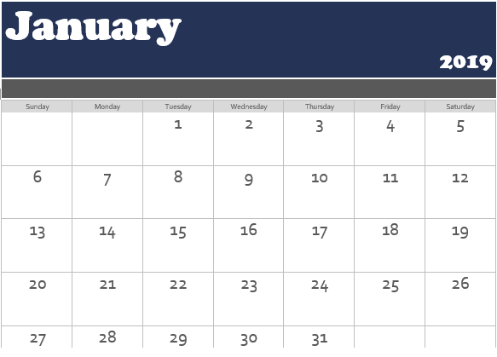
DeductionS: Days in Pay Period for TRAF
Once you have the total annual TRAF that you should pay, you must divide this by the number of teaching days in the year (195 in 2018-19), and then your deduction is determined by the actual number of teaching days in each pay period.
So how many teaching days were included on the January 31st Pay Period of 2019?
As you can see from the Calendar on the right, there were 12 days in this pay period.

Slide 21
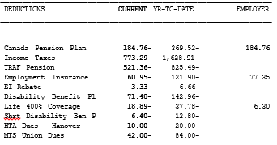
DeductionS: TRAF Calculation
TRAF Deduction = Annual Contribution ÷ Days in Year x Days in Pay Period
= $8472.18 ÷ 195 x 12
= $521.36
Note: TRAF is now conducting variance reports more frequently, so if your TRAF deduction doesn’t match up with your calculation, then it may be the result of additional income (acting principal, for example), or a reduction in income (a personal day without pay, for example). Either way, send me a question if you think there may be an error.

Slide 22
DEDUCTIONS: Employment Insurance
Employment Insurance Premiums are paid at a rate of 1.62% of your taxable salary, up to a maximum of $860.22 in 2019.
Taxable Salary (Calculated earlier): $3762.25
EI = 1.62% of your taxable salary
= 0.0162 x $3762.25
= $60.95

Slide 23
Deductions: Disability benefits plan
Your 2018-19 premium for the Disability Benefits Plan is 1.9% of your taxable salary.
DBP Deduction = 1.9% of Taxable Salary multiplied by 24 pay periods:
= 0.019 x $90,294 / 24
= $71.48

Slide 24
Deductions: Short-term Disability benefits plan
Your 2018-19 premium for the Short-Term Disability Benefits Plan is 0.17% of your taxable salary (this will increase to 0.18% after March 2019).
STDBP Deduction = 0.17% of Taxable Salary multiplied by 24 pay periods:
= 0.0017 x $90,294 / 24
= $6.40

Slide 25
Deductions: HTA Dues
The HTA Dues for the 2018-19 school year were set at $240 by our HTA Council at the end of the 2017-18 year.
HTA Dues = $240.00 ÷ 24
= $10.00

Slide 26
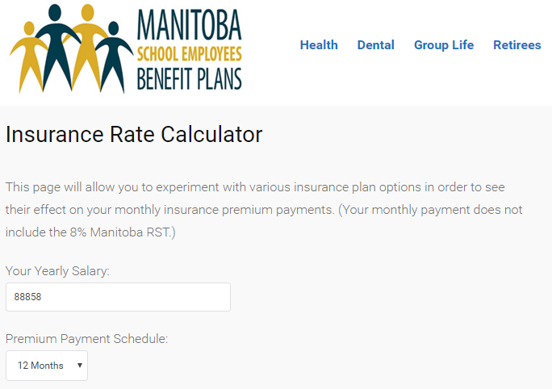
DEDUCTIONS: Life insurance
Life Insurance is another deduction that is different for everyone. Hanover School Division shares the cost of the minimum of 200%. Some only have the minimum, while others may have up to 700%. You can learn more about this coverage on the Manitoba School Employees Benefits Plans website. As you go through, you will find the Insurance Rate Calculator, that shows the many options that could impact each member’s rate.
NOTE: 200% coverage means the payout in the event of your death is 200% of your salary. For “SALLY PAYCHECK,” the payout would be 400% of her salary. You will note that HSD shares the premium for the first 200%, while she pays the premium for the remaining 200% coverage.
http://mpsebp.ca/manitoba-public-school-employee-group-life/

Slide 27
Deductions: MTS Union Dues
The MTS Union Dues are set each year at the Society’s Annual General Meeting. For 2018-19, this fee was set at $1008 for the year.
MTS Dues = $1008.00 ÷ 24
= $42.00

Slide 28
FINAL CHECKS
Now that you’ve looked at all the earnings and deductions, you should also make a point of checking the “Banked” days on your stub, as well as the summaries, to make sure everything is correct.
Are the number of personals days you have left correct?
Are the number of accumulated sick days you have left correct?
Do all of your deductions add up to the total at the bottom?
Is the net pay at the bottom correct, and is it the amount that is actually deposited into your account?

Slide 29
Questions?
CONTACT:
Wendell Head
President, Hanover Teachers’ Association
(204)392-3396
president@hanoverteachers.com
OR CONTACT:
Glen Anderson
Staff Officer, Manitoba Teachers’ Society
(204)831-3052
ganderson@mbteach.org

